Slide 1
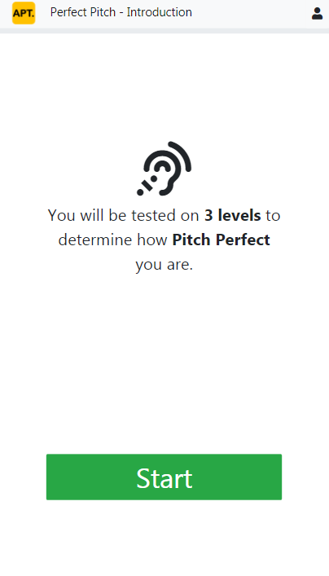
This is an app that would test the Pitch Perfect-ness of the user.
I’ll be incorporating other tests in the future; personality test, language test, etc.

Slide 2
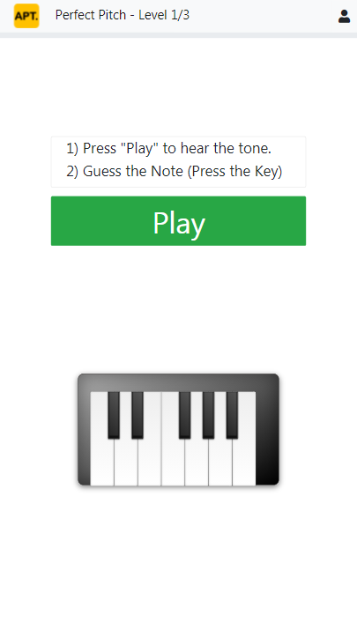
The user will walk through 3 levels of increasing difficulty.
Their pitch perfect-ness is scored.

Slide 3
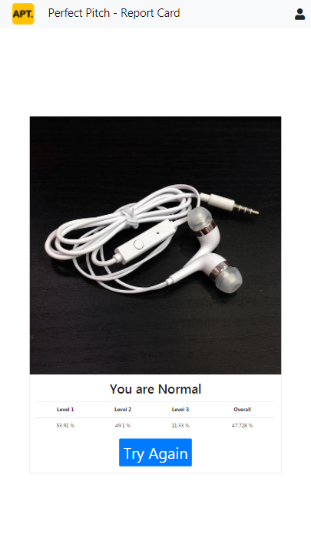
Currently the user is only able to see the percentage of accuracy with respect to him/herself.
I would like to provide further ranking and comparison amongst different demographics through this app.

